Slide 1
Sybase ASE:
Compression option
http://andrewmeph.wordpress.com
mailto: andrew.me.ph@gmail.com
Rev. 11.2012

Slide 2
Note and disclaimer:
Information posted in this and other presentations found here by no mean represent Sybase official position. It is an independent opinion based on functionality tests performed in controlled testing environment.
Although the author made its best to represent data in an accurate and unbiased manner, there is always a possibility of an error.
The opinions expressed by this and other presentations must be taken with a degree of skepticism. Since SAP Sybase allows to test before purchasing most of its products and product options, it is strongly recommended to run performance and/or functionality tests on local systems. No two systems are identical. Things good for Zeus may be harmful for a bull.

Slide 3
ASE Compression: Quick info
Compression option was introduced into Sybase ASE in the 15.7 version, disclosed at 2010 Tech-wave.
In Sybase ASE compression is available on several levels:
  On a row level, by means of which empty data on a data row is eliminated.
  On a page level, by means of which in addition to eliminating empty row data, duplicate data on each page is replaced by a token and a link.
  For LOB objects, as ASE implementation of FastLZ (LZO) and ZLib (LZW.26) compression algorithms (out of scope of this paper).
Compression is a licensed option and must be enabled the same way encryption, partitioning, &c options are enabled.

Slide 4
Compression: row level
Row-level compression is intended for fixed-length, regular data.
For most fixed-length columns, data does not completely occupy the space reserved for the row.
    32-bit integer with a value of 2 is represented by 0x10 in hexadecimal. Adaptive Server requires 1 byte to represent this value, but fills the other 3 bytes of the row with zeros. Similarly, if a 50-byte fixed-length character column includes the character data “a”, Adaptive Server requires 1 byte for the character data, but completes the column with zeros.
Some fixed-length data-types are not compressed because there is no benefit in doing so.
For a complete list of data-types and their possible compression levels, advise the “Compression Users Guide” available at http://infocenter.sybase.com/help/topic/com.sybase.infocenter.dc01667.1570/doc/pdf/ase_compression_users.pdf.

Slide 5
Compression: PAGE level
Page-level compression addresses data redundancy on a page.
When you specify page-level compression for regular data, Adaptive Server performs row-level compression first, then page-level compression.
Adaptive Server includes a number of techniques for page-level compression:
  Extracting repetitive information from variable-length byte strings and replacing them with shorter symbols. When you insert a new row into a data page, Adaptive Server first compares the data in the columns with the symbols in the page dictionary.
  Extracting and removing short, duplicate values that use fixed-length columns from the rows. Adaptive Server stores the duplicate value in the page index, and uses a status bit in the row to indicate that this value is stored in the page index and is available for compression.
Compression does not automatically occur on a table configured for page-level compression until you insert a row that causes the page to become full.

Slide 6
Compression: enabling
Compression may be turned on on different levels
On database level:
  CREATE DATABASE DB … WITH COMPRESSION = PAGE | ROW | NONE
  ALTER DATABASE DB … SET COMPRESSION = PAGE | ROW | NONE
On table level:
  CREATE TABLE … WITH COMPRESSION = <type>
  SELECT INTO … WITH COMPRESSION = <type>
  ALTER TABLE SET COMPRESSION = <type> followed by REORG REBUILD
On partition level*:
  partition by ... ([part_name] ... [with compression = {page|row }] ...)
On column level:
  CREATE TABLE TBL (colA int not null NOT COMPRESSED, colB int null) WITH COMPRESSION = ROW
On session level:
  SET COMPRESSION ON|DEFAULT
* This allows you to compress data only for specific partitions. Partition may be compressed / decompressed as needed using alter table .. modify partition … set compression = {type} clause.

Slide 7
Compression: disabling
Compression may be turned off on different levels.
On database level:
  ALTER DATABASE DB … SET COMPRESSION = NONE
On table level:
  ALTER TABLE SET COMPRESSION = NONE (followed by REORG REBUILD)
On partition level:
  ALTER TABLE … MODIFY PARTITION … SET COMPRESSION = NONE...
On column level:
  ALTER TABLE TBL MODIFY ColA int NOT COMPRESSED
On session level:
  SET COMPRESSION OFF
Turning on/off compression does not affect the rows already stored in a table. The table/partition must be rebuilt to enforce the actual data compression type. A table may have compressed and uncompressed data co-existing side by side.

Slide 8
Compression: retrieving
Compressed data is first decompressed, then returned to client
BCP OUT – any compressed rows (including those with text data) are decompressed and returned to the client, either in native or character form.
BCP IN – uncompressed data received from the client is compressed during the insert. BCP IN selects the appropriate compression scheme, which depends on the compression level of the partition into which you are inserting the row.
DUMP DATABASE dumps compressed data directly from disk to archive

Slide 9
Compression: restrictions
“Compression is restricted for in-memory databases. Loading and recovering compressed objects in disk-resident or relaxed-durability in-memory databases is permitted. However, Adaptive Server often restricts access to compressed objects in the target in-memory database.”
  What this cryptic statement means is that you may load a compressed DB dump into IMDB, but at your own risk. I have been able to access compressed table data in IMDB. But the statement raises concern about IMDB functionality with compression turned on for the source DB.
“Adaptive Server provides minimal support for disabling compression in the target database or in tables defined for compression, so you may revert to using uncompressed data.”
  Not very obvious what “minimal support” actually means. Anyway, you will get an error message when attempting to turn compression on in IMDB.
Compressed LOB columns do not support replication.

Slide 10
Compression: to be or not to be?
According to the “Compression Users Guide” compression is said to be beneficial in three ways:
  Use less storage space for the same amount of data
  Reduce cache memory consumption
  Improve performance because of lower I/O demands
I have performed practical tests to check each of the suppositions.
What you will find in the remainder of this paper is some data that addresses each of these claims.

Slide 11
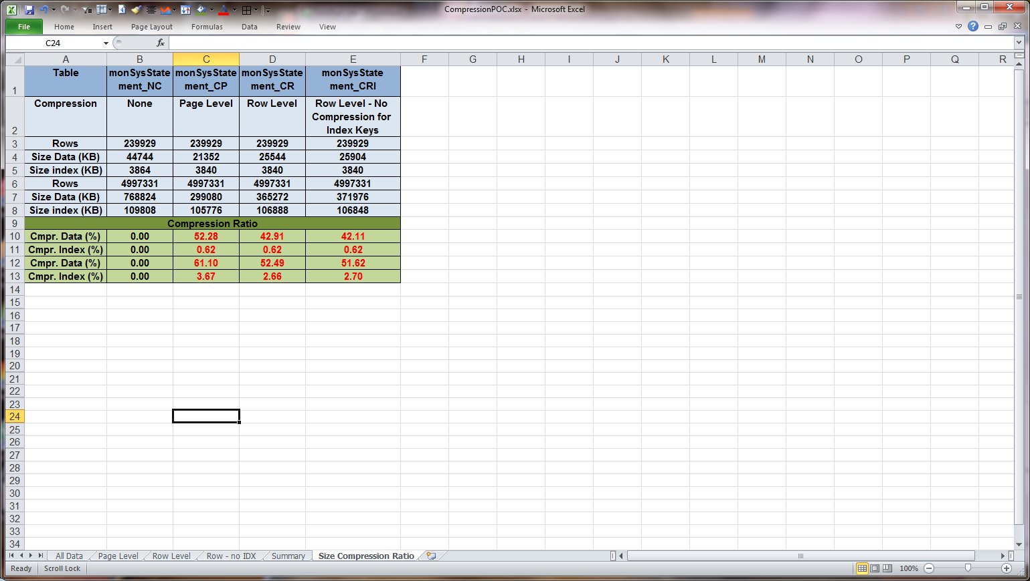
Compression: storage usage
It is obvious that the compression ratio is strongly influenced by the type of data a table contains (both in terms of data-types & in terms of actual data values).
Below is a compression ratio for a sample table that contains only fixed size data-types: monSysStatement (mostly integer values).

Slide 12
Compression: storage usage
From the standpoint of storage economy, compression may easily result in reducing the size of your data by more than a half.
Page-level compression allows the greatest degree of compression, since it includes row-level compression. For this sample table page-level compression added an additional 10% economy over the row-level compression.
* The numbers here are very much table/data specific and should not be taken as absolute values.

Slide 13
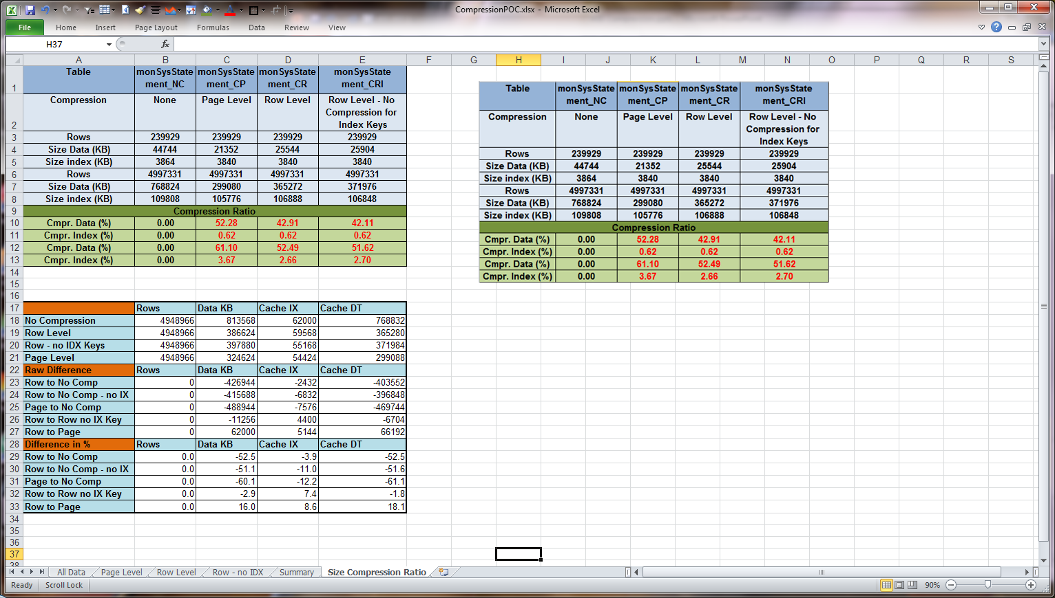
Compression: Cache usage
Below is the impact compression has had on a data cache for our sample table.
Pretty straightforward too: since objects have shrunk in size, their cache footprints are reduced by a comparable ratio.

Slide 14
Compression: Improve performance
This claim is much more complicated…
It is quite obvious that reduced IO activity may give ASE an extra breathing space: Less IO = Less Waits = Less Context Switches = Less Exhausted Time Slices = Less Cache Turnover &c…
And yet, we must not forget that compression, for all its reduced IO benefits, has its price: we must decompress and lookup compressed values in page dictionary/page index for each compressed data row.
So what is more efficient: cutting the stored data size by half or avoiding ASE engine overhead of decompressing & locating compressed values?

Slide 15
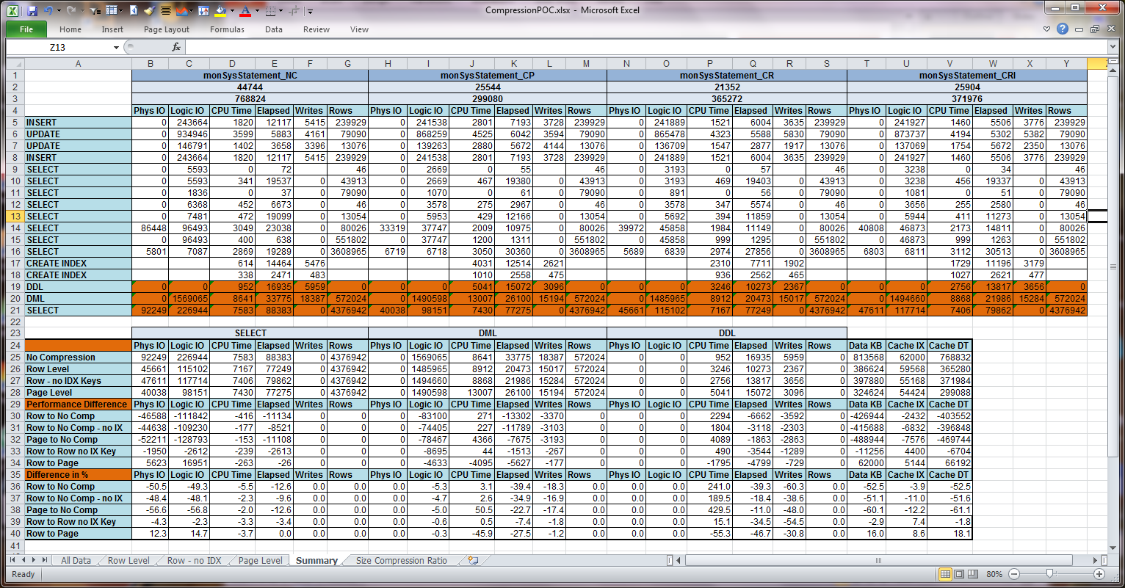
Compression: performance
I have summarized below Statistics IO/Time details when working with different compression levels for inserts, updates, selects and index creation on the same sample table.

Slide 16
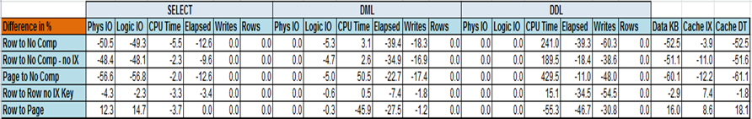
Compression: performance
What we may see from this general picture is that raw CPU Time ASE spends on servicing the same types of requests may grow by 20% to 430% factor. For an overloaded ASE this may be bad news.
BUT - DML/DDL/SELECT operations fare quite differently:
  For SELECT operations, compression is definitely a beneficial feature (less CPU/Elapsed time, far less Logical/Physical IO).
  For DMLs, compression is beneficial for response time (lower Elapsed Time), but CPU Time may grow by 10% to 50%, depending on compression type.
  For DDL (create index), compression causes ASE to do 200%-450% more CPU work (CPU Time), but curiously enough, response time is still better (10%-40% drop in Elapsed Time).
As said earlier, cache / storage usage benefits from compression.

Slide 17
Compression: conclusion
We have seen that ASE compression is quite an impressive feature:
  It may be configured with a great ease (even on separate partition level).
  It is great for storage/data cache economy (60%+ space economy).
  It reduces response time as a rule.
Still, CPU time for DML/DDL requests may grow by 50% to 450% factor. Page level compression is definitely a feature not to be used thoughtlessly on a busy OLTP system. Row level compression seems to have a moderate impact, although it use too must be tested first.
All in all, this is an option worth diving into – especially but by no means only for DSS systems with partitioning.

Slide 18
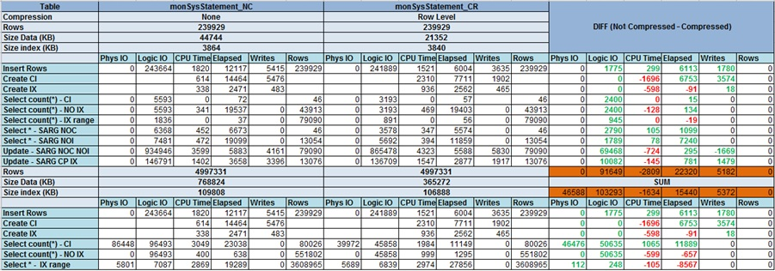
Compression: addendum
Row-level compression footprint on:
Create index (clustered/non-clustered).
Select (count(*),*,via Index, Table Scan, Ranges).
Inserts, Updates (via Index, Table Scan).
For small sized/large sized table.

Slide 19
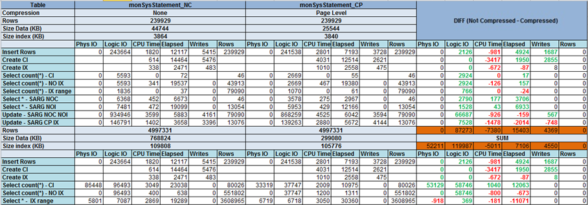
Compression: addendum
Page-level compression footprint on:
Create index (clustered/non-clustered).
Select (count(*),*,via Index, Table Scan, Ranges).
Inserts, Updates (via Index, Table Scan).
For small sized/large sized table.

Slide 20

Compression: addendum
Row-level compression (index keys spared) footprint on:
Create index (clustered/non-clustered).
Select (count(*),*,via Index, Table Scan, Ranges).
Inserts, Updates (via Index, Table Scan).
For small sized/large sized table.

Slide 21
feedbacks
Feedback and corrections may be either sent directly to andrew.me.ph@gmail.com or posted as comments in the blog space.
The blog is available at http://andrewmeph.wordpress.com.
More presentations/tools are available for download throughout the blog space.
You are welcome to post your own ideas there which may be later transformed into customized tools/feature tests and posted for the benefit of general public.

